Slide 1
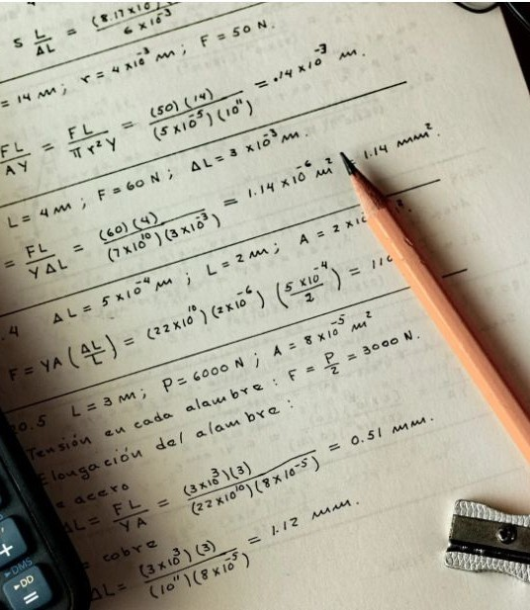
VisionMaths
CPG No. 140
Mentors:
Dr. Nitin Arora
Dr. Sumit Sharma

Slide 2
Anushka Verma (102203699)
Aryan Mishra (102203357)
Bhavya (102203806)
Harshit (102203526)
Members
Nikhil Sharma (102203474)
Presentation Title

Slide 3
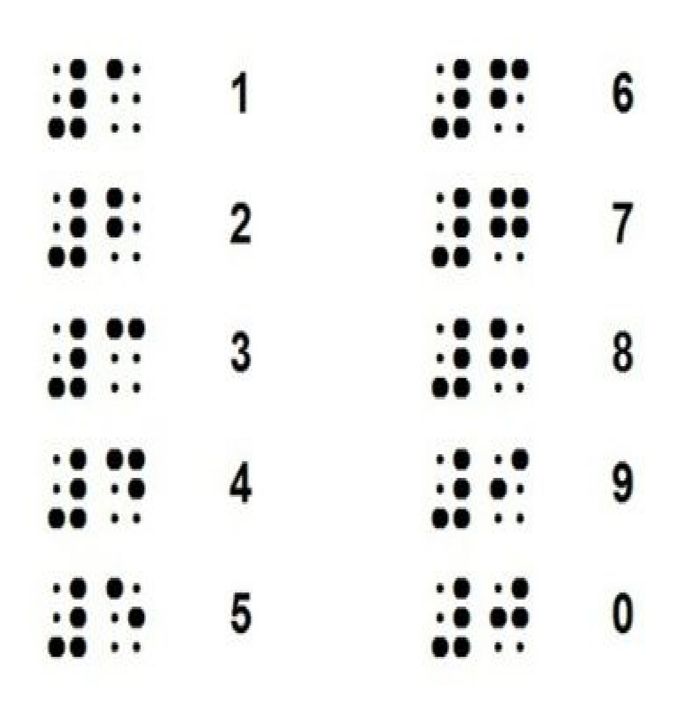
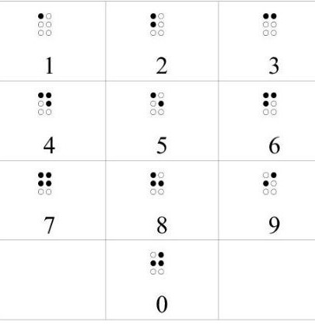
Project Overview
VisionMaths is a smart learning system that helps visually impaired students learn mathematics easily. It introduces an interactive, adaptive Braille display that adjusts in real time to represent numbers and math symbols.
Smart Braille Hardware: Dots move automatically to display math symbols.
ML - Powered Learning: Machine learning algorithms interpret and convert simple mathematical equations into Braille.
III. Seamless Integration: An intuitive software interface ensures effortless interaction between users and the system.
3

Slide 4
Problem Statement
Objectives
Outdated Braille Tools – Lack real-time updates & interactivity.
Develop a straightforward and easy to use website that promotes independent learning for the visually impaired.
Limited Digital Access – Restricts textbooks & online resources.
High Dependence – Requires sighted
Compare different ML algorithms and identify the best dataset for training.
Create a responsive Braille learning system with real time movement of braille dots using hardware.
assistance for learning.
"To develop learning system
an integrated with adaptive
platform,
students
Braille hardware enabling to learn
and a dynamic online visually impaired
Integrate the hardware and software to create an easy-to-use learning platform.
mathematics independently and access up- to-date educational content."

Slide 5
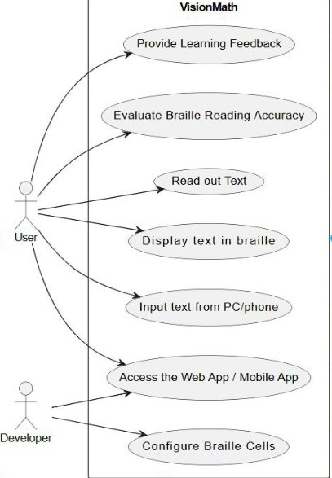
Use Case Diagram

Slide 6
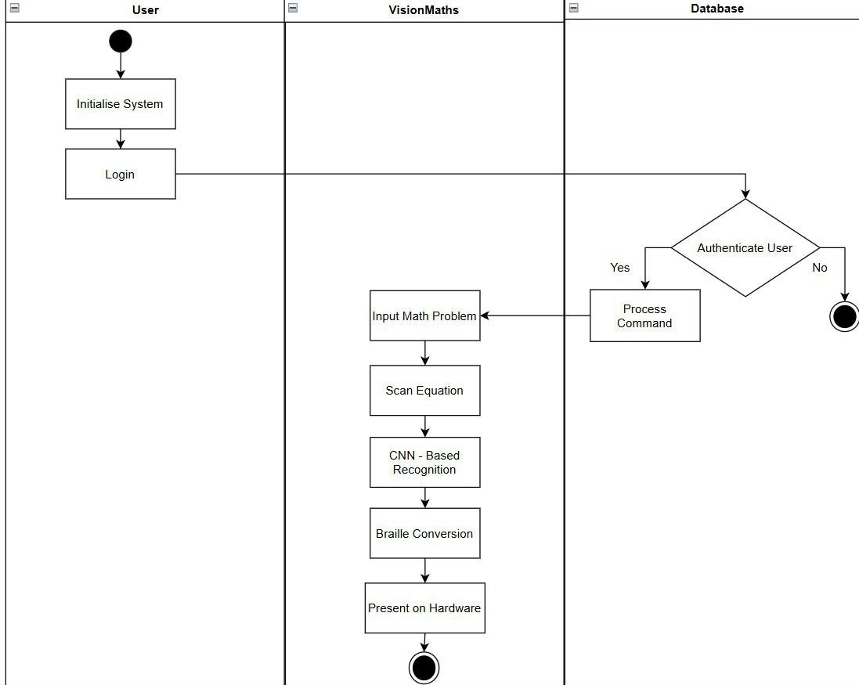
Swim Lane Diagram

Slide 7
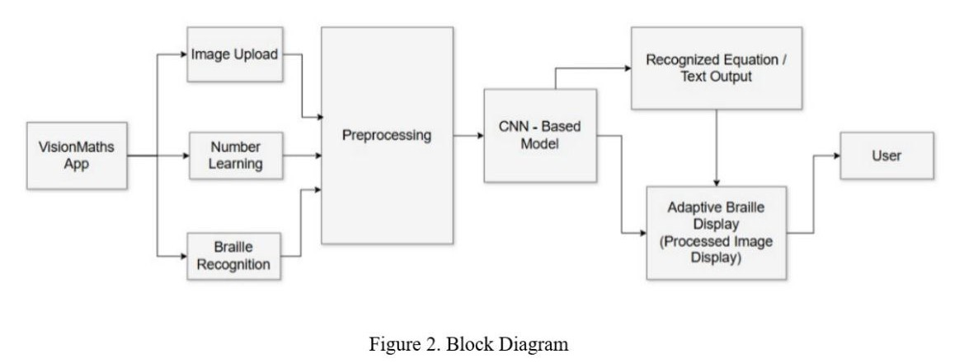
Project UML Diagrams

Slide 8
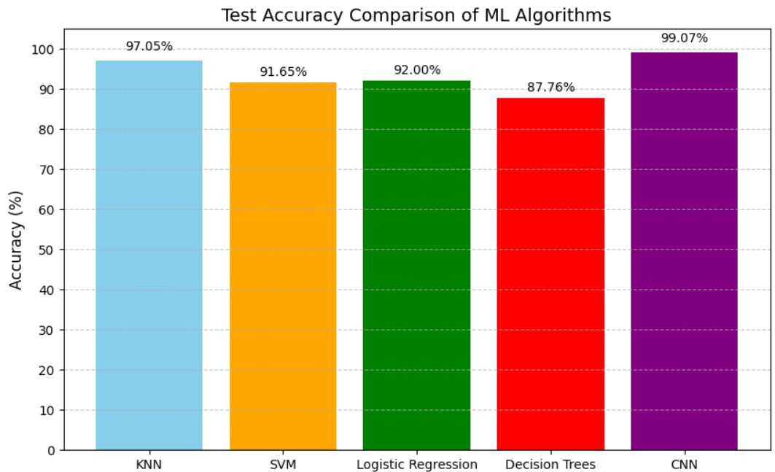
ML Algorithms Comparison Chart

Slide 9
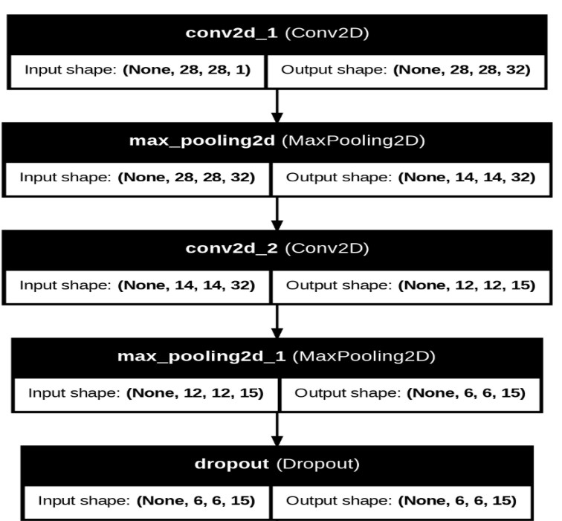
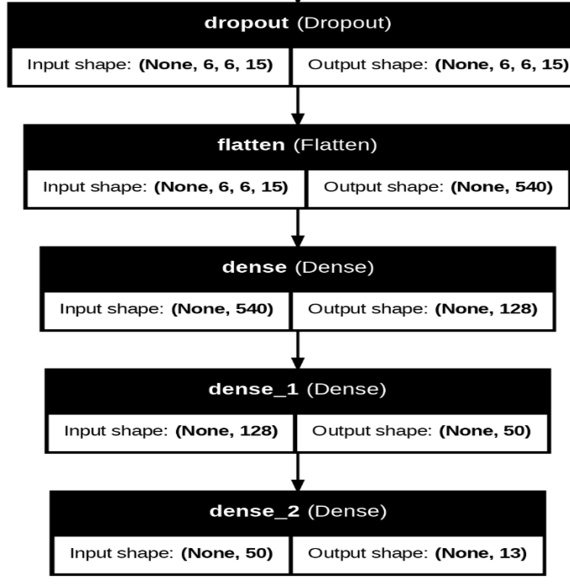
CNN Model Architecture

Slide 10
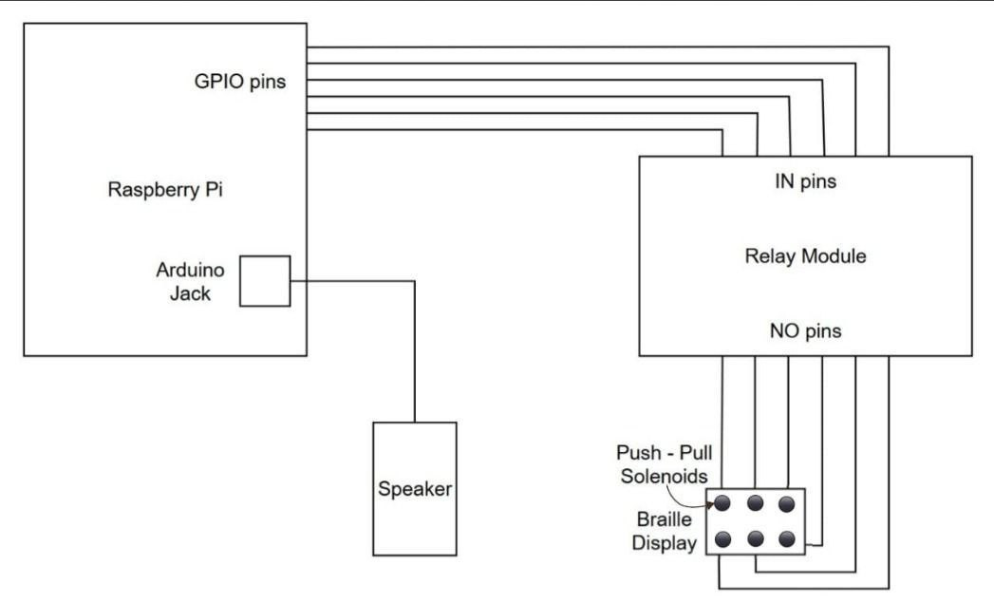
Hardware Design

Slide 11
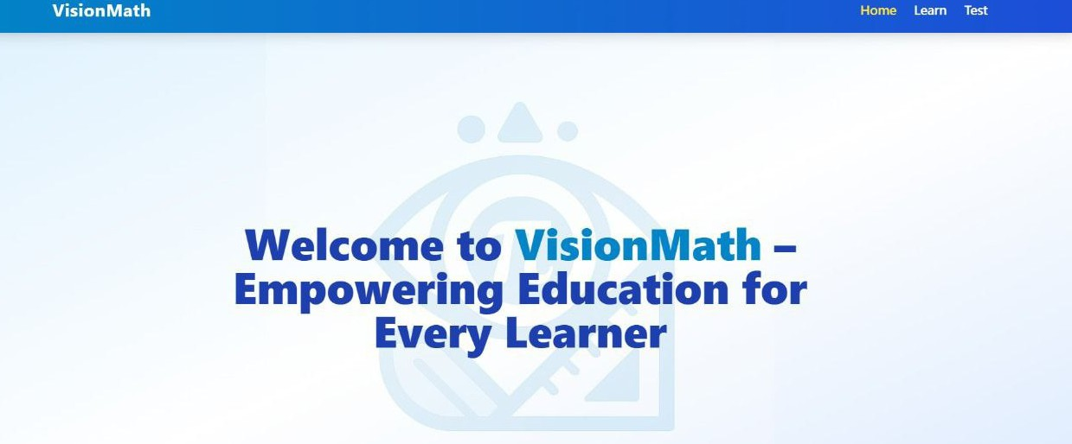
UI/UX Design

Slide 12
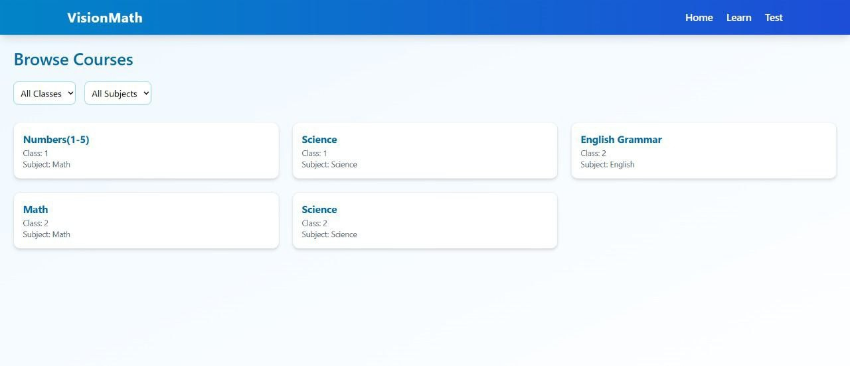
UI/UX Design

Slide 13


Project Outcomes
Enhanced Accessibility Improved Learning Efficiency Accurate Braille Translation Bridging Learning Gaps Convenient and Reliable Solution

Slide 14
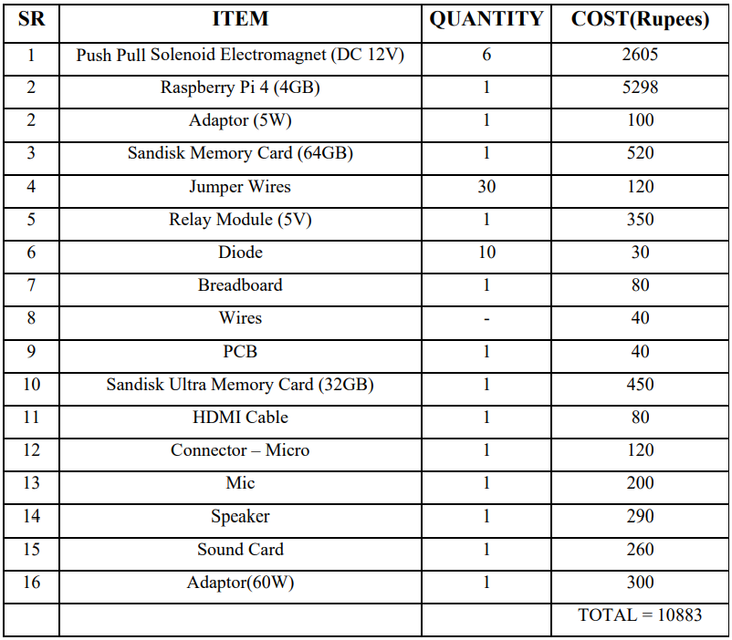
Cost Analysis

Slide 15
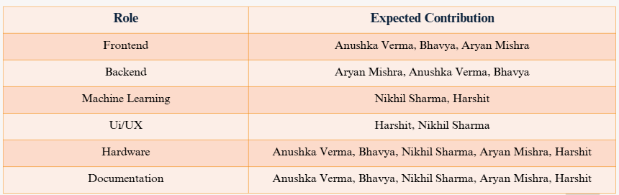
Individual Roles

Slide 16
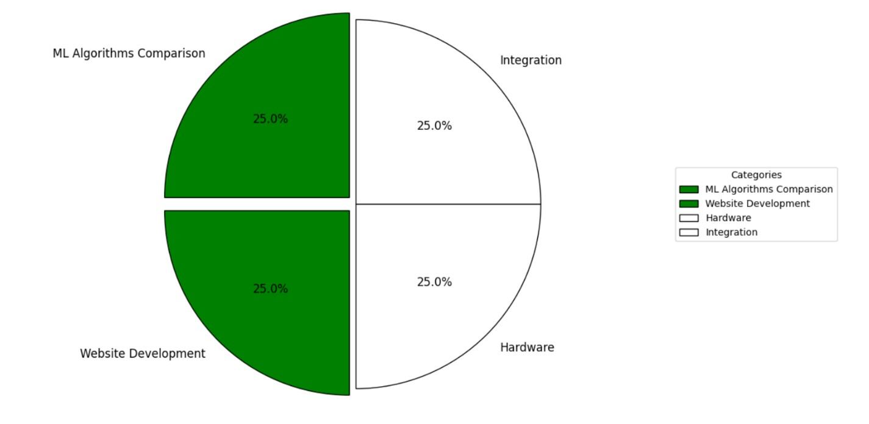
Progess Till Now

Slide 17
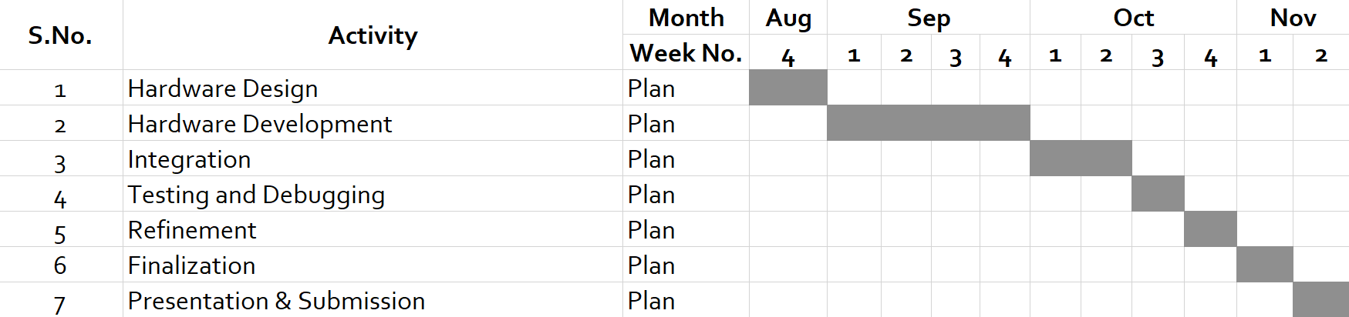
Future Work Plan

Slide 18
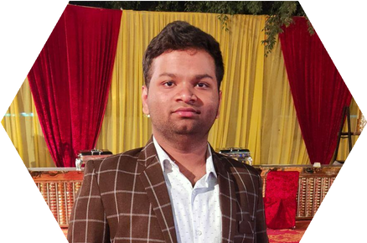

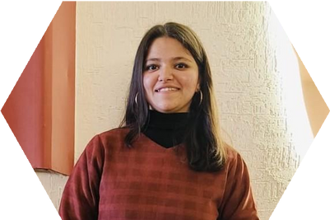
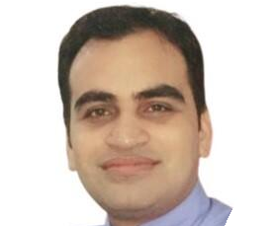
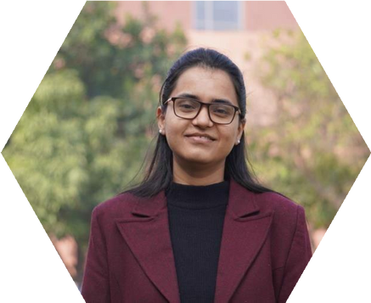
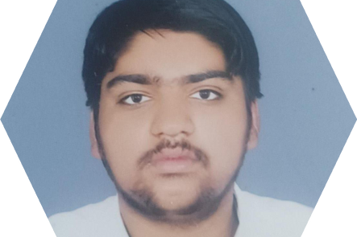
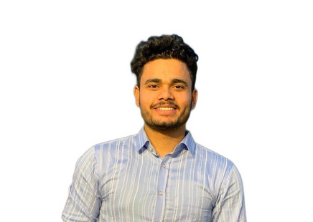
Meet our team
Harshit
Anushka Verma
Bhavya
Dr. Nitin Arora
Dr. Sumit Sharma
Nikhil Sharma
Aryan Mishra

Slide 19
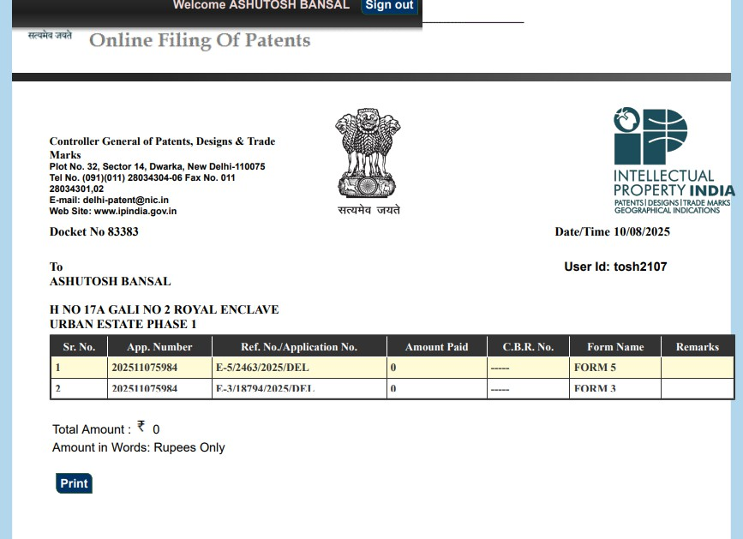
Patent Application

